Slide 1


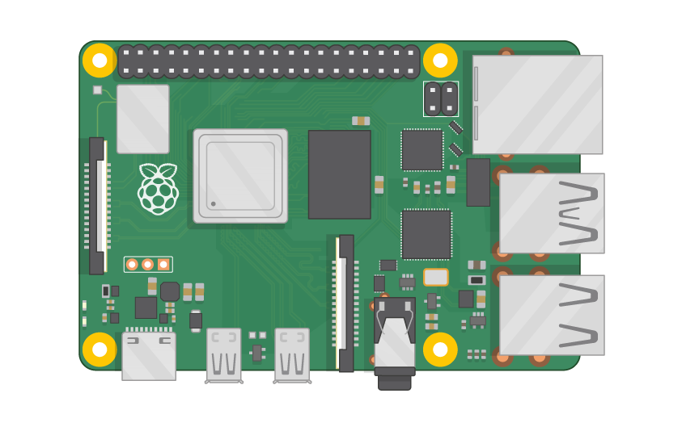
Raspberry Pi Master Class Day-8
LCD Display Interface with RPi

Slide 2
Table of Contents
01
02
03
04
Liquid Crystal Display
Interface LCD with RPi
Overview
Practical session
Discussion & Tech news
Q&A
Interactive session
Interractive session

Slide 3
PREREQUISITES FOR THIS COURSE
Raspberry Pi 3 Model b/B+
16 GB SanDisk class 10 SD Card
Card reader
Laptop with Internet
Power Adapter – 5V 2Amps
USB B-Type Cable
LCD & 10K Trimpot

Slide 4
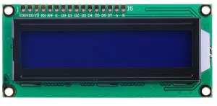
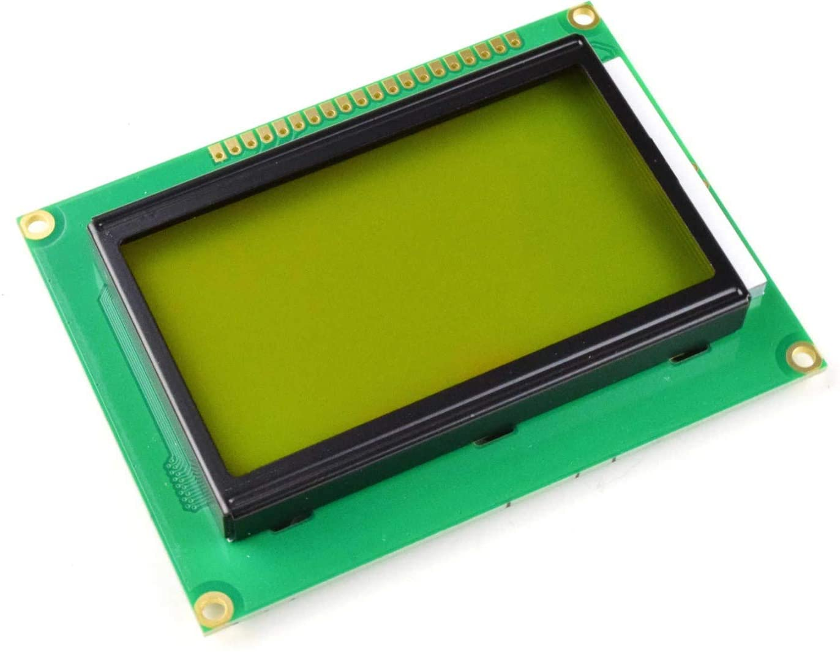
Liquid Crystal Display…
A liquid-crystal display (LCD) is a flat-panel display or other electronically modulated optical device that uses the light-modulating properties of liquid crystals combined with polarizers.
Liquid crystals do not emit light directly, instead using a backlight or reflector to produce images in color or monochrome.

Slide 5
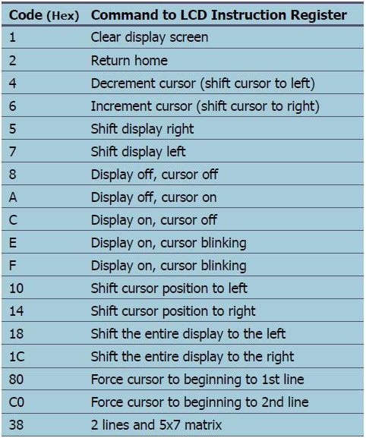
LCD Commands

Slide 6
Installing Library
sudo pip3 install RPLCD

Slide 7
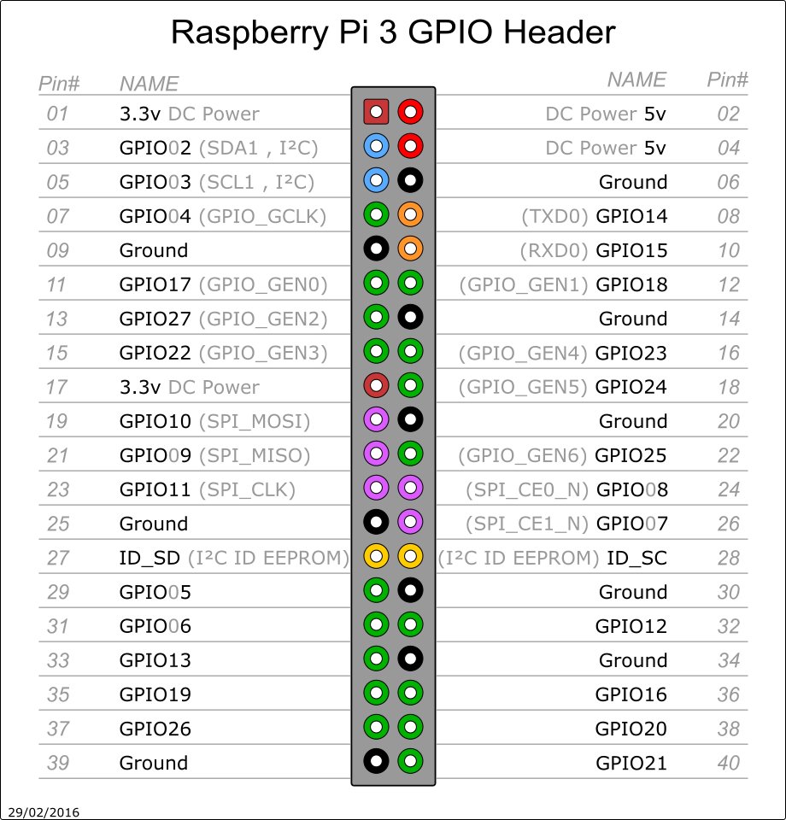
Pin Out of RPi3

Slide 8
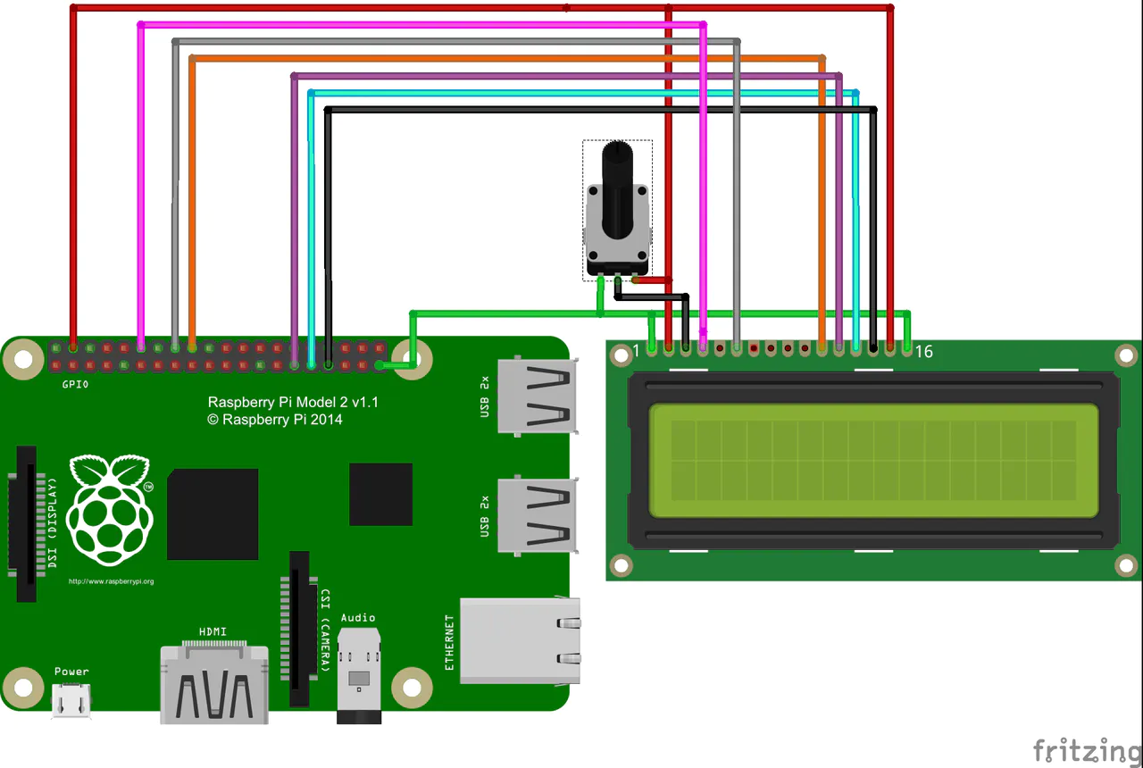
LCD with Rpi…

Slide 9
30-Days Lecture Video
25+ Source Codes
Bonus Lectures
Join - Raspberry Pi Master Class
Flexible Time
Forum Support
Materials Download

Slide 10
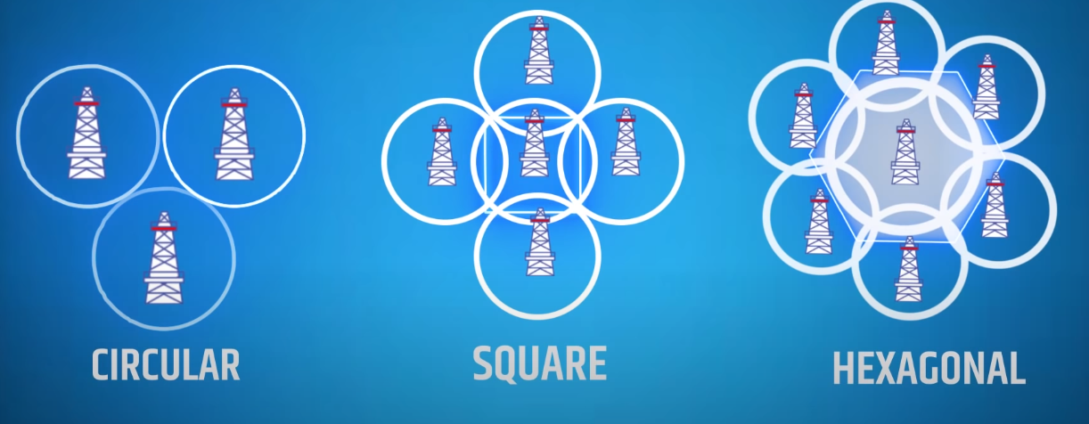
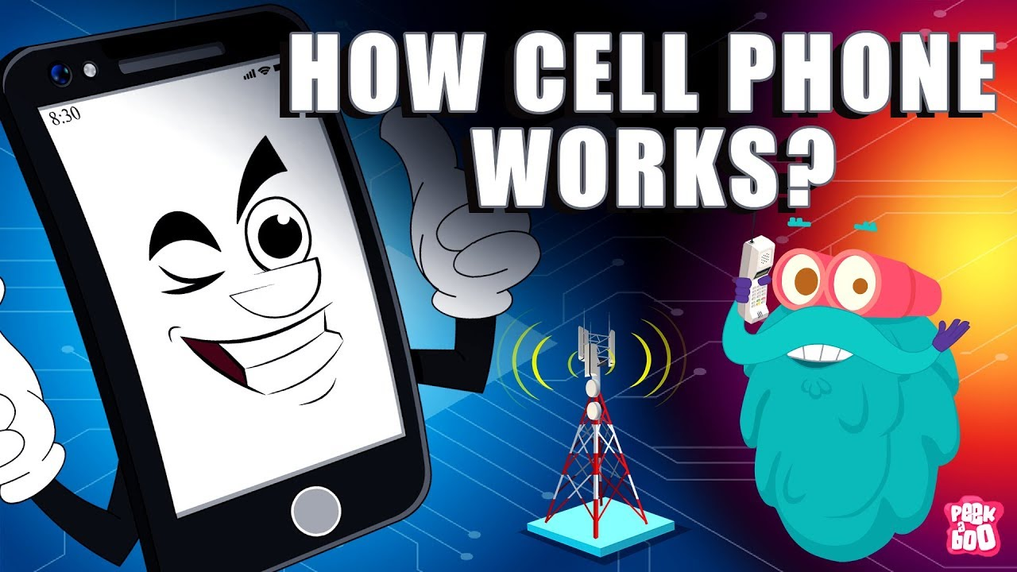
Q8 – Discussion
On the time of call, First to Near Tower(Base Transceiver station)
Base Station Controller - BSC
Mobile Switching Station – MSC Contains ur info
Other network Mobile Switching Station – MSC Reciever Info
Base Station controller – BSC
Tower
Receiver Mobile
CELLULAR NETWORK
How mobile works?

Slide 11
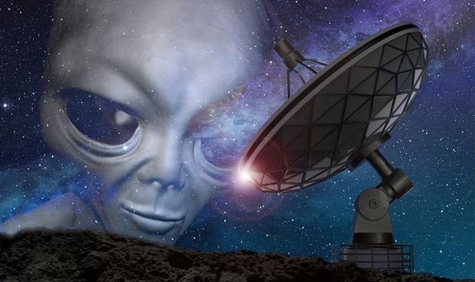
Q9 – Discussion
Radio signals - Aliens

Slide 12
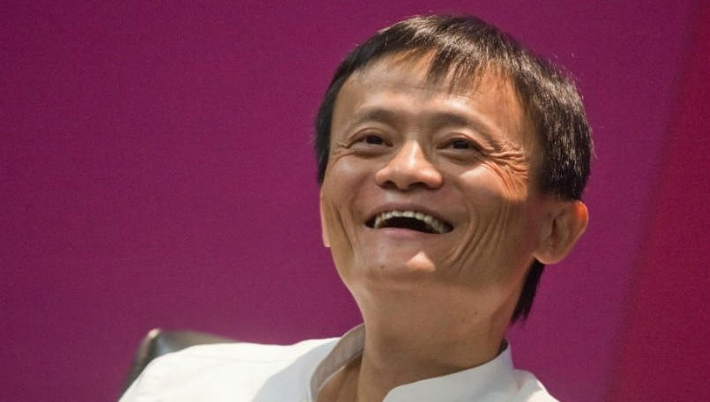
Tech billionaire and Alibaba founder Jack Ma missing after conflict with Chinese govt
Tech News - 8
Jan - 2021
Alibaba founder Jack Ma has been reported as missing and the tech billionaire has not been spotted for the past 2 months now. Jack Ma was recently replaced as a TV show judge in the final episode of ‘Africa Business Heroes’ The final episode of the show aired on November, shortly after Ma “made a candid speech criticising China’s regulators and its state-owned banks”. Alibaba’s spokesperson said that “due to a schedule conflict Mr Ma could no longer be part of the finale judge panel of Africa’s Business Heroes earlier this year (2020)”.

Slide 13
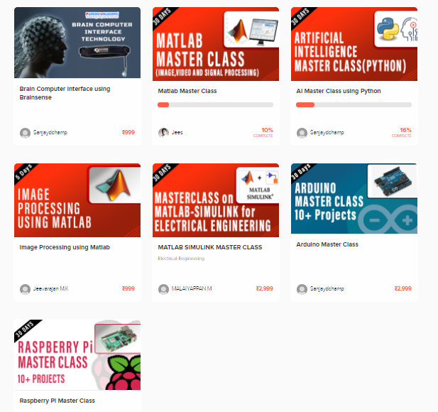
Thanks!
learn.pantechsolutions.net
www.pantechsolutions.net
“Imagination is more important than knowledge”
-Albert Einstein

